Slide 1
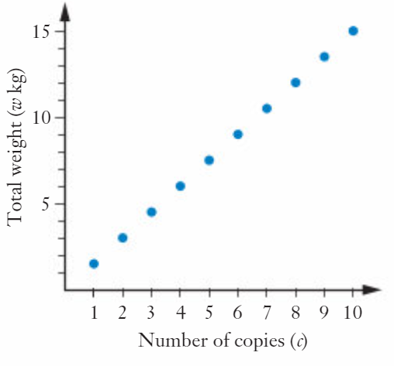

Situation One
Suppose that each copy of a particular book weighs 1.5kg.
If we place copies of this book on a set of scales, each time we add one more book so the weight shown will increase by 1.5kg.
We can model this in two ways:
Number of copies, c | 1 | 2 | 3 | 4 | 5 | 6 | 7 | 8 | 9 | 10
Number of kg, w | 1.5 | 3 | 4.5 | 6 | 7.5 | 9 | 10.5 | 12 | 13.5 | 15
What rule connects c and w?
$$w=1.5c$$

Slide 2
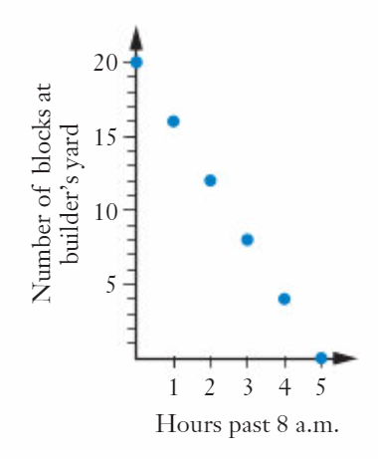
Situation Two
At 8am one morning there are 20 large concrete blocks in a builders yard that need to be delivered to a worksite. A truck from a transport company is due to arrive at the builders yard in one hour to pick up four blocks, take the to the worksite and then return for four more one hour later, repeating the process until all 20 blocks have been removed.
We can model this in two ways:
Number of hours past 8am, h | 0 | 1 | 2 | 3 | 4 | 5
Number of blocks at the yard, n | 20 | 16 | 12 | 8 | 4 | 0
What rule connects h and n?
$$n=20−4h OR n=−4h+20$$

Slide 3
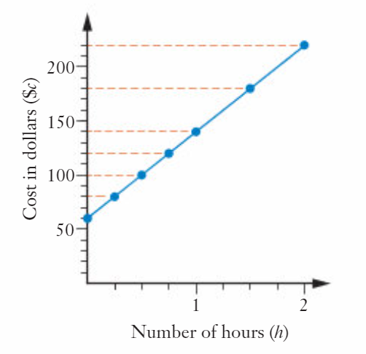
Situation Three
The graph below shows the amount charged by a plumber working at your house for up to 2 hours.
We can model this in two ways:
Number of hours, h | 0 | 0.25 | 0.5 | 1 | 1.5 | 2
Cost in dollars, c | 60 | 80 | 100 | 140 | 180 | 220
What rule connects h and c?
$$c=80h+60$$

Slide 4
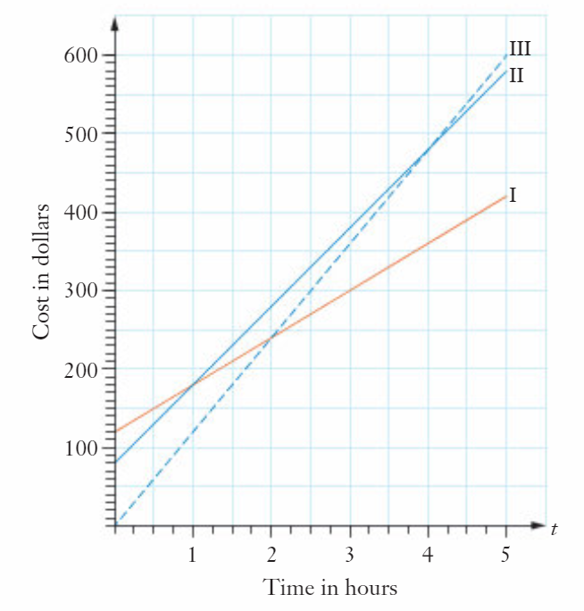
Situation Four
Three electricians, Sparky, Flash and Voltman, have different ways of calculating a customer’s bill.
Sparky charges a standard rate per hour and has no other charges
Flash has a fixed, or ‘standing’ charge and then charges a certain amount per hour on top of that
Voltman has a higher standing charge than Flash but then charges less per hour
Which graph I, II or III corresponds to each electrician?
Who charges the most per hour?
What is the equation of each line?
Which electrician is never the cheapest?
I=Voltman, II=Flash, III=Sparky
Sparky, line is the steepest
$$I C=120+60t II C=80+100t III C=120t$$

Slide 5
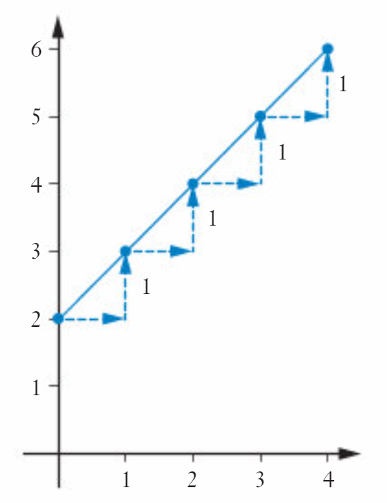
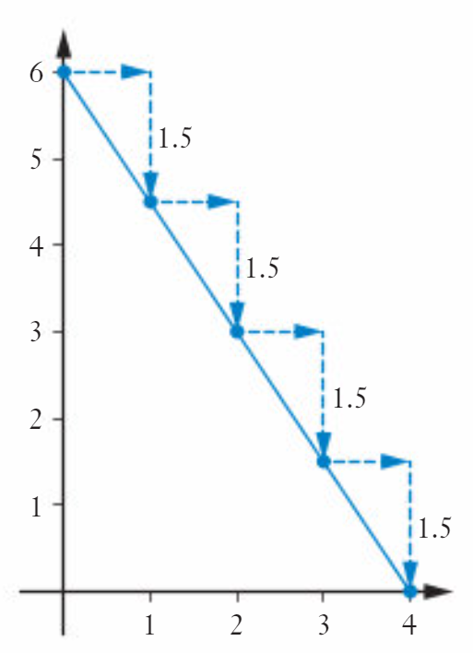
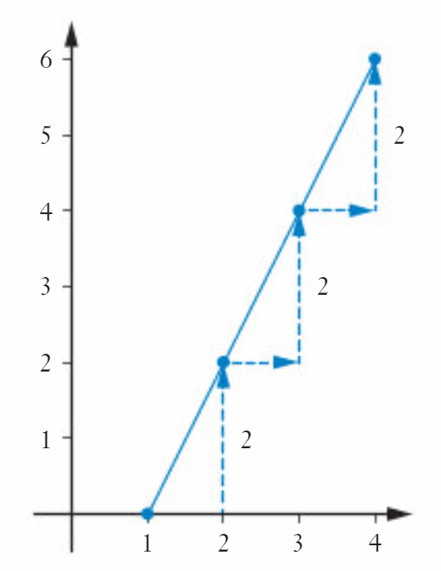
The gradient of a straight line
The vertical rise for each for each horizontal unit increase is called the gradient or slope of the straight line.
As we move across horizontally 1 unit, the line moves up 1 unit
Gradient = 1
As we move across horizontally 1 unit, the line moves up 2 units
Gradient = 2
As we move across horizontally 1 unit, the line moves down 1.5 units
Gradient = -1.5

Slide 6
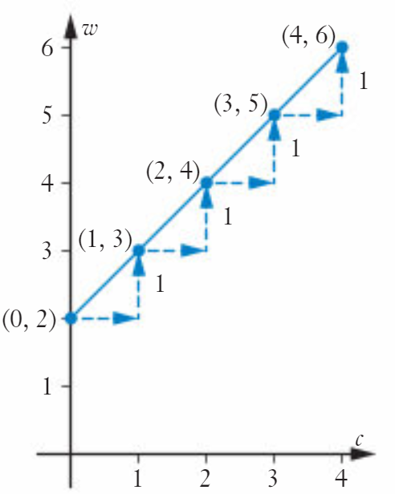
Table of Values
Using a table of values we can find the gradient as well
1
1
1
1
C | 0 | 1 | 2 | 3 | 4
w | 2 | 3 | 4 | 5 | 6
1
1
1
1
As we move across horizontally 1 unit (a change of 1 in the c row)
The line moves up 1 unit (a change of 1 in the w row)
Gradient = 1

Slide 7
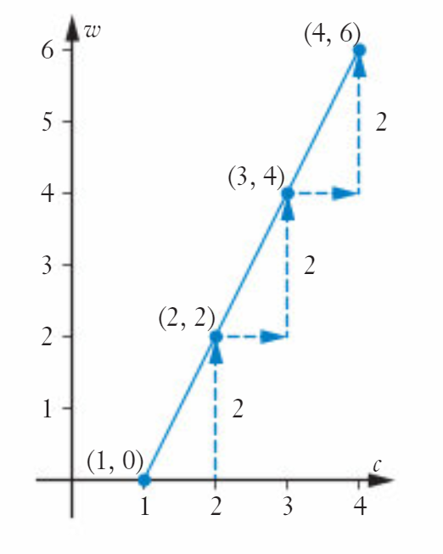
Table of Values
Using a table of values we can find the gradient as well
1
1
1
C | 1 | 2 | 3 | 4
w | 0 | 2 | 4 | 6
2
2
2
As we move across horizontally 1 unit (a change of 1 in the c row)
The line moves up 2 unit2 (a change of 2 in the w row)
Gradient = 2

Slide 8
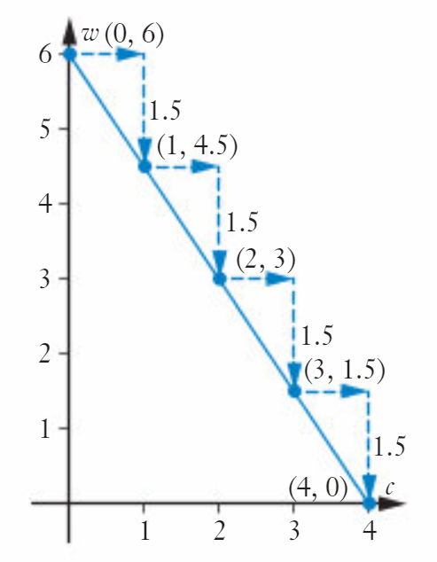
Table of Values
Now try Exercise 8A
Using a table of values we can find the gradient as well
1
1
1
1
C | 0 | 1 | 2 | 3 | 4
w | 6 | 4.5 | 3 | 1.5 | 0
-1.5
-1.5
-1.5
-1.5
As we move across horizontally 1 unit (a change of 1 in the c row)
The line moves down 1.5 units (a change of -1.5 in the w row)
Gradient = -1.5

